Slide 1
Digital Portfolio
STUDENT NAME: J.KISHORE
REGISTER NO AND NMID: 24CA107 AND NMID:
DEPARTMENT: BCA
COLLEGE: MADRAS UNIVERSITY

Slide 2
PROJECT TITLE
DIGITAL PORTFOLIO

Slide 3


AGENDA
Problem Statement
Project Overview
End Users
Tools and Technologies
Portfolio design and Layout
Features and Functionality
Results and Screenshots
Conclusion
Github Link
3/21/2024 Annual Review

Slide 4

PROBLEM STATEMENT
Hi, I’m Kishore, a passionate Data Analyst skilled in uncovering insights from complex datasets. I specialize in data visualization, statistical analysis, and business intelligence to help organizations make data-driven decisions.

Slide 5

PROJECT OVERVIEW
I specialize in data visualization, statistical analysis, and business intelligence to help organizations make data-driven decisions.

Slide 6

WHO ARE THE END USERS?
The employers, employes and the manager,analysists etc

Slide 7

TOOLS AND TECHNIQUES
CSS, Java script and Html
And most important is PowerBi

Slide 8
POTFOLIO DESIGN AND LAYOUT
Dark Theme – Clean, modern, and professional look. Good contrast with accent blue.
Clear Sections – About Me, Skills, Projects, Contact – neat and easy to navigate.
Skill Cards – Minimal and well-structured; recruiters can quickly scan your expertise.
Projects Showcase – Short descriptions make it easy to understand impact.
Contact Info – Straightforward with email, LinkedIn, and GitHub (great touch).
8

Slide 9
FEATURES AND FUNCTIONALITY
Skills Section
Instead of only listing tools, group into categories:
Data Analysis → SQL, Excel, Python (Pandas, NumPy)
Visualization → Power BI, Tableau, Matplotlib
Machine Learning Basics → Statistics, Clustering, Regression
Design Layout
Added subtle animations (hover effects on project cards, smooth scroll, fade-in).
Improve spacing: More white space between sections to avoid compactness.
The “Projects” filter buttons (All, Dashboards, Analysis, Automation) look great → but add active highlight animation for better UX.

Slide 10
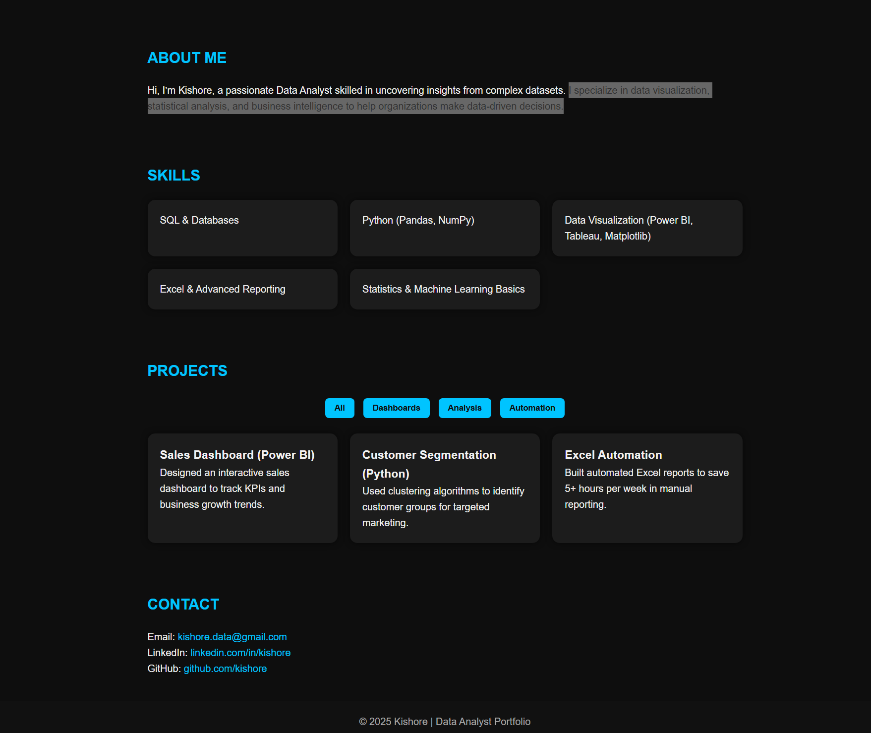

RESULTS AND SCREENSHOTS
3/21/2024 Annual Review
10

Slide 11
CONCLUSION
This project demonstrates how data analysis and visualization can transform raw datasets into meaningful business insights. By leveraging tools such as SQL, Python, Excel, and Power BI, the project showcases skills in data cleaning, reporting, and automation. The implemented dashboards and reports not only provide clarity in decision-making but also highlight efficiency gains, such as saving time in manual processes. Overall, this portfolio reflects a strong foundation in data analytics and a readiness to apply these skills in real-world scenarios.
https://github.com/thekishorej07-bot/TNSDC-FWD-Dk.git
11

Slide 12
GITHUB LINK
https://github.com/thekishorej07-bot/TNSDC-FWD-Dk.git
12

